Slide 1
WhispervoidXAI Academy| 2025
ARTIFICIAL INTELLIGENCE
https://www.instagram.com/whispervoidxai/

Slide 2
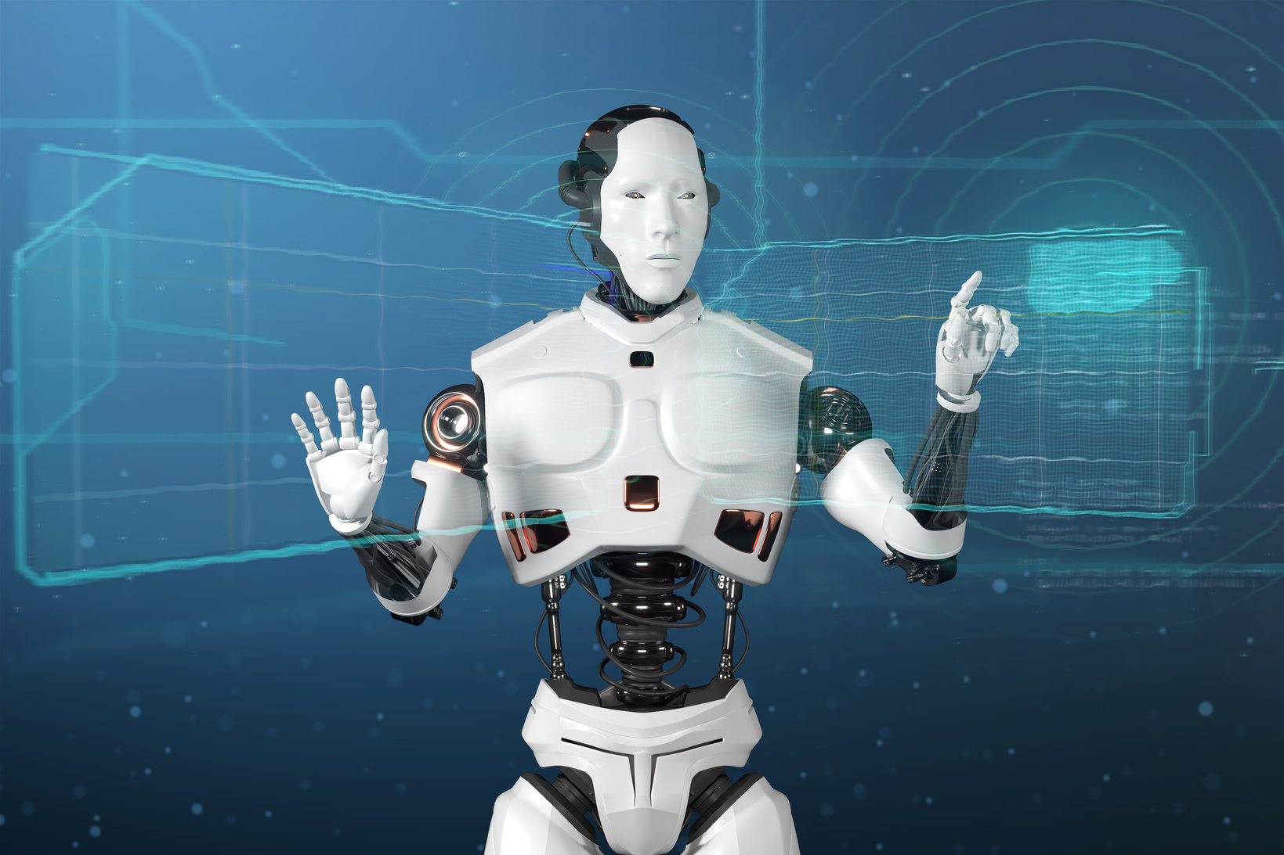
WhispervoidXAI Academy| 2025
Market Basket Analysis Using Apriori and Association Rules
Objective:
Discover purchasing patterns across products.
Support marketing decisions (offers, product rankings).
Tools: Python, Pandas, Mlxtend, Matplotlib.

Slide 3
WhispervoidXAI Academy| 2025
Project steps
Data Preparation:
Converting transaction data into a table suitable for analysis.
Pattern Extraction:
Using the Apriori algorithm to extract the most frequent clusters.
Rule Building:
Applying association rules using Support and Confidence.
Visualizing Results:
Displaying relationships between products using parallel coordinates.

Slide 4
WhispervoidXAI Academy| 2025
RESULTS AND USE
Results:
Identifying products that are often purchased together.
Ordering rules based on the strength of the relationship (confidence).
Usage:
Improving product arrangement in the store.
Designing marketing offers (bundle offers).
Conclusion:
The project helps understand customer behavior and improve sales strategies using artificial intelligence.

Slide 5
WhispervoidXAI Academy| 2025
Engineer Ibrahim Al-Taamari
THANK YOU
https://www.instagram.com/whispervoidxai/

